Slide 1

Building Custom Visual Studio Team
Service Build Tasks
with VSTS DevOps Task SDK
Roshan Louhar
Associate Consultant
https://roshanlouhar.in

Slide 2
Prerequisites
Node.js & npm
tfx-cli npm package (globally installed)
Cross-Platform CLI for Microsoft Team Foundation Server & Visual Studio Team Services
vsts-task-lib npm package (local to the project)
VSTS DevOps Task SDK for developing the custom task
Visual Studio Team Services Account

Slide 3
CLI for Microsoft Team Foundation Server &
Visual Studio Team Services
Interacts with Microsoft TFS and Visual Studio Team Services
Cross platform
- Supported on Windows, Linux and OS X
Enables you to interact with
Builds – View, queue, get details for builds
Build Tasks – Create, upload, list, delete build tasks
Extensions – Package, publish, manage VSTS/TFS Build tasks
Work Items – View, create & query work items
https://github.com/Microsoft/tfs-cli

Slide 4
VSTS DevOps Task SDK
Libraries for writing build/deployment tasks for VSTS
Libraries for Node.js and PowerShell
Use TypeScript
Write tasks that are cross-platform
Node.js platform
Use PowerShell
Runs only on Windows
https://github.com/Microsoft/vsts-task-lib

Slide 5
Important Files
package.json
Reference vsts-task-lib and any 3rd party npm packages
sample-task.ts/js
Your custom logic for the Visual Studio Team Services build/release task
icon.png
Icon used for the custom task on Visual Studio Team Services
task.json
Describes the task and used to render the configuration options on screen

Slide 6
Demo
S t u d i o T e a m S e r v i c e B u i l d T a s k s
B u i l d i n g
C u s t o m
V i s u a l
w i t h
V S T S
D e v O p s
T a s k S D K

Slide 7
Where To Go From Here?
Publish the task to Visual Studio Marketplace
Make it available for
Private Use
Public Use – Publisher must be verified with Microsoft
Payment models
Free
Paid + Trial

Slide 8
Thank You
S e e Y o u i n t h e N e x t E p i s o d e
Kasun Kodagoda
https://wpdevkvk.wordpress.com

Slide 9



Extensions in VSTS and TFS
Tulsa TechFest 2016
Jeff Bramwell
VP – Enterprise Architecture, Farm Credit Services of America MVP - Visual Studio & Development Technologies jeff@moonspace.net ::: @jbramwell
Friday, August 5th

Slide 10



Tulsa TechFest 2016
|
Fri, Aug 5th, 2016
|
OSU - Tulsa
|
70+ Speakers, 20+ Tracks & 85+ Sessions!

Slide 11





Tulsa TechFest 2016
|
Fri, Aug 5th, 2016
|
OSU - Tulsa
|
70+ Speakers, 20+ Tracks & 85+ Sessions!

Slide 12


Agenda
Ways You Can Extend
Custom Hubs
Custom Widgets
Custom Build Tasks
Service Hooks
More on the Marketplace
Continuous Integration/Delivery
Summary

Slide 13

Let’s take a deeper look at:
EXTENSIONS

Slide 14
Ways You Can Extend
REST APIs
Service Hooks
External Tools
Build Tasks
Web UI Integration
Full
Integration

Slide 15
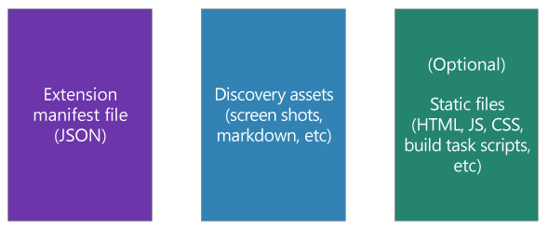
Components of an Extension
An extension is made up of:
+
+

Slide 16
G^{on s} et the Client SDK
npm install vss-web-extension-sdk
Add VSS.SDK.js to home/sdk/scripts

Slide 17
Let’s take a quick look at:
CUSTOM HUBS

Slide 18

Custom Hubs
Requires an HTML page
Requires a vss-extension.json manifest file
Requires a reference to the VSS.SDK.js library
Uses JavaScript and TypeScript (optional)

Slide 19
Hub Groups
Home: ms.vss-web.home-hub-group
Code: ms.vss-code-web.code-hub-group
Work: ms.vss-work-web.work-hub-group
Build: ms.vss-build-web.build-hub-group
Release: ms.vss-releaseManagement-web.hub-group-rm
Test: ms.vss-test-web.test-hub-group
Admin (collection): ms.vss-web.collection-admin-hub-group
Admin (project): ms.vss-web.project-admin-hub-group

Slide 20
Creating a Custom Hub
DEMO

Slide 21
Let’s take a quick look at:
CUSTOM WIDGETS

Slide 22
Custom Widgets
Widgets are displayed on dashboards in VSTS/TFS
Very similar to custom Hubs
Requires an HTML page
Require a vss-extension.json manifest file
Requires a reference to the VSS.SDK.js library
Uses JavaScript and TypeScript (optional)

Slide 23
Creating a Custom Widget
DEMO

Slide 24
Let’s take a quick look at:
CUSTOM BUILD TASKS

Slide 25
Build Tasks
Typically written in PowerShell and/or TypeScript
Use TypeScript for cross-platform tasks
Can also integrate .NET code if desired/needed
Also requires a vss-extension.json manifest file

Slide 26
Creating a Custom Build Task
DEMO

Slide 27
Let’s take a quick look at:
SERVICE HOOKS

Slide 28
Service Hooks
Built-in feature of VSTS/TFS
Integrate with 3rd party services
Can also integrate with custom services
No coding required to integrate with existing services

Slide 29
Available Services
AppVeyor
Azuqua
Azure App Service
Azure Service Bus
Azure Storage
Bamboo
Campfire
Flowdock
HipChat
Hubot
Jenkins
MyGet
Office 365
Slack
Trello
UserVoice
Web Hooks
Zapier
Zendesk

Slide 30
Setting up a Service Hook
DEMO

Slide 31
Let’s take another look at:
MARKETPLACE

Slide 32
Visual Studio Marketplace
Includes Visual Studio, VSTS and Visual Studio Code
Public preview made available last November
Hundreds (thousands?) of extensions available now
Monetization is not yet available but is planned
User reǀieǁs are aǀailaďle… author Đan also respond to reǀieǁs
Can use web site and/or command line to publish

Slide 33
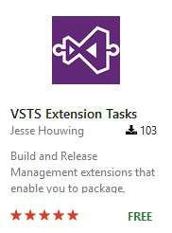
Continuous Delivery
Published by Jesse Houwing (MVP)
Publishes your extensions to Marketplace
Can be shared with one or more accounts
Can override version (task and extension)
Can make public or private (several options)

Slide 34
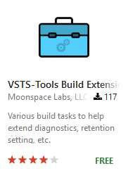
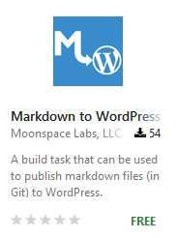
My Extensions
VSTS-Tools Build Extensions
Markdown to WordPress

Slide 35
Summary
VSTS/TFS can be extended in many ways
You can extend your automated builds as well as the web UI
Customizations can make full use of existing REST APIs
Build customizations can be Windows specific or cross-platform
You can share your extensions in the Visual Studio Marketplace
At some point you will be able to charge for them if desired
Start here: http://bit.ly/VSTSExtensions

Slide 36

Questions? More
Information?
Extensions Reference for VS Team Services and TFS
http://bit.ly/VSTSExtensions
Brian Harry (Product Unit Manager for TFS)
https://blogs.msdn.microsoft.com/bharry/
My Blog
http://blog.devmatter.com
Code/Extension Examples
https://github.com/jbramwell/VSTS-Tools

Slide 37







Your input is important!
http://TulsaTechFest.com
Tulsa TechFest 2016
|
Fri, Aug 5th, 2016
|
OSU - Tulsa
|
70+ Speakers, 20+ Tracks & 85+ Sessions!

Slide 38

Building
WITH VISUAL STUDIO ONLINE & TEAM FOUNDATION SERVER
Jeff Bramwell
Director – Enterprise Architecture, Farm Credit Services of America
Visual Studio ALM MVP
@jbramwell :::: blog.devmatter.com

Slide 39

Agenda
What’s Neǁ?
Web-based UI
MiŶd Your P’s aŶd Q’s
Build Agents Build Definitions Build Tasks
Cross Platform Support Summary

Slide 40

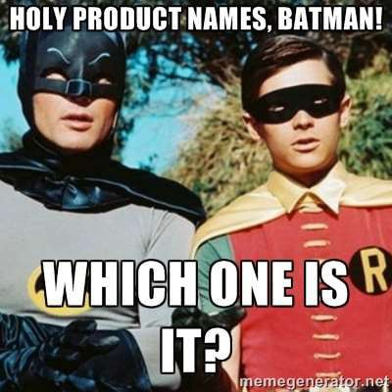
But First, Let’s Clear Things Up…

Slide 41

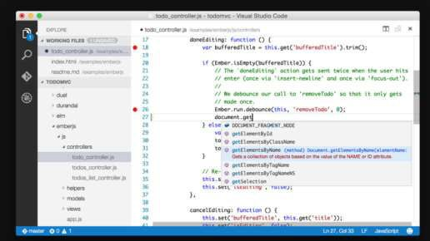
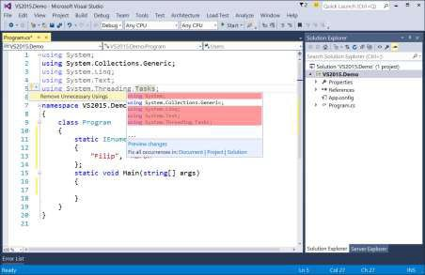
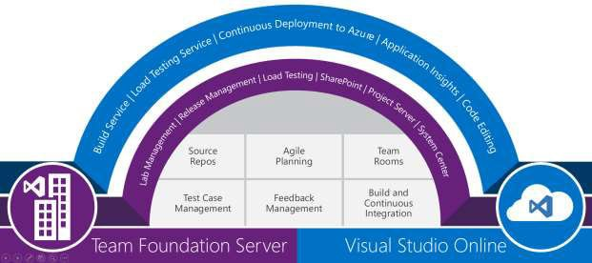
What is What?
Team Foundation Server
Visual Studio Online Visual Studio
Visual Studio Code

Slide 42
What’s New?
No more XAML/Workflow!
Web-based UI Cross Platform Task-Based
Extensible
Open Source
Version History
Not tied to TFS/VSO

Slide 43
What’s Missing?
Create work item on build failure
Create label on build success
Update work item(s) with build number
Count-based retention policies (works different than before)

Slide 44
To XAML or not to XAML?
For new projects (or projects without build definitions), use the new builds
For cross-platform builds, use the new builds
If migrating an existing project (e.g. from TFVC to Git) consider updating to the new builds
If heavily invested in custom XAML builds/activities, continue with XAML builds until existing
custom logic can be ported to the new builds
XAML
But, iŶ geŶeral…

Slide 45
Web UI
Build definitions now created in browser – not Visual Studio
Build definitions can be created from anywhere!
If Ǉou’re used to TeaŵCitǇ/JeŶkiŶs, theŶ Ǉou’ll feel at hoŵe ☺
Builds can be queued and monitored in real time

Slide 46

DEMO
OUR FIRST LOOK AT THE WEB UI

Slide 47


Mind Your P(ools) & Q(ueues)
No more Build Controllers!
We Ŷoǁ haǀe…
Pools
Define permission boundaries around build agents
Tied to the TFS App Tier Instance – or – the VSO Account
Can be shared across Team Project Collections
Queues
Scoped to Team Project Collection
Associates a Pool with one or more Build Definitions

Slide 48
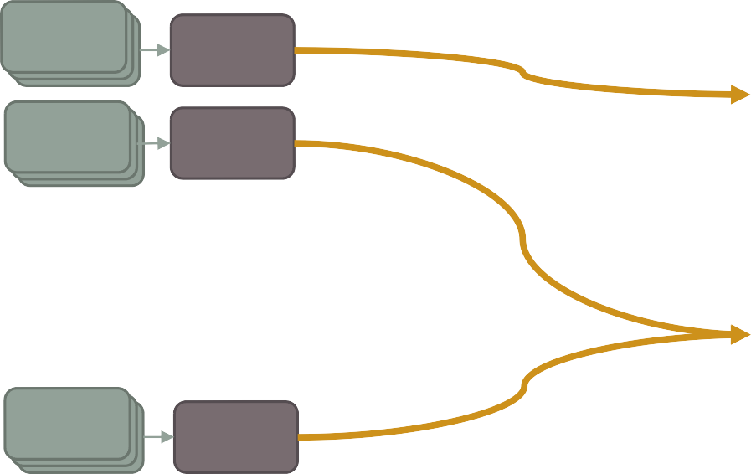




Agent Pools & Queues – Cont’d
Project Collection
Pools
(TFS AT/VSO Account)
Build Agents
Build
Def’s
Agents 1-4
Queue-1
Pool-1
Build
Def’s
Queue-2
Apply permissions at the pool level
Agents
5-6
Capabilities determine the agent
Agent 7
Project Collection
Pool-2
Agent 8
Build
Def’s
Queue-3
Build
Def’s
Queue-4
(X-Plat)
Agents
9-10
Pool-3

Slide 49


Build Agents
Brand new architecture
Open Source!
https://github.com/Microsoft/vso-agent/
͞ǆĐopǇ͟ deploǇaďle
Cross platform
Easy to install and configure
Self-updating!
No build controller required
Can run as Windows service or interactive (e.g. command line)

Slide 50
DEMO
P’S & Q’S

Slide 51
Build Tasks
Cross-platform
Open source
https://github.com/Microsoft/vso-agent-tasks
CurreŶtlǇ 37 tasks aǀailaďle out of the ͞ďoǆ͟ Currently 45 in GitHub (so, more to come!) Ability to create/upload custom tasks coming
Written in JavaScript/TypeScript/PowerShell
Configured via JSON (task.json)

Slide 52
DEMO
A LOOK AT A TASK’S INTERNALS

Slide 53

Cross Platform Support
Mostly straight-forǁard… the folloǁiŶg platforŵs are supported:
Windows, requires:
Visual Studio 2013/2015
PowerShell 3 or newer
OS X, requires:
Node & npm
Linux, requires:
Node & npm
Cross platform agent available here:
https://www.npmjs.com/package/vsoagent-installer

Slide 54
In Summary
The new build architecture is:
Much simpler!
Web based
Community-oriented (i.e. open source)
Better/easier extensibility
Cross platform
And, most of all, NO XAML!

Slide 55

References
VSO Build Agent
https://github.com/Microsoft/vso-agent
VSO Build Agent Tasks
https://github.com/Microsoft/vso-agent-tasks
VSO/TFS Features Timeline
https://www.visualstudio.com/en-us/news/release-archive-vso
Team Foundation Build Reference on MSDN
https://msdn.microsoft.com/en-us/Library/vs/alm/Build/overview
BriaŶ HarrǇ’s Blog
http://blogs.msdn.com/b/bharry/
My Blog ☺
http://blog.devmatter.com

Slide 56

Questions?

